Slide 1
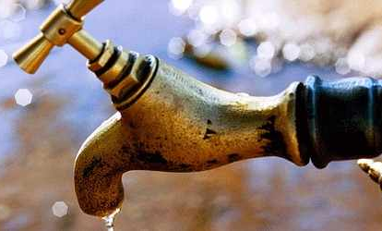
«Water Sector Reform in Kenya »
Trainings 24.-28.8. and 28.9.-2.10.2015
Notes:
Before you go on to read about the individual technologies discussed later in this document, it is helpful to understand some of the basics of wastewater treatment. You will see terms like BOD, total suspended solids, nitrification, and denitrification frequently when discussing wastewater treatment. It is important to understand what each of these terms mean and how each relates to the wastewater treatment process. Some very basic processes of wastewater treatment are also briefly discussed. If you understand the theory behind these basic treatment processes it is easy to see how and why the processes are applied in the various alternative technologies discussed later.

Slide 2
Basic Treatment Processes
Based in parts on several DWA/Engicon presentations, modified by Margraf Publishers

Slide 3
Table of Content
Preliminary treatment
Secondary treatment
Sludge handling

Slide 4
Preliminary treatment: general
The purpose of preliminary treatment is to protect plant equipment by removing those materials that could cause clogs, jams, or excessive wear to plant machinery.
Removal of various materials at the beginning of the treatment process saves valuable space within the treatment plant.
Preliminary treatment processes may include:
screening, shredding, grit removal, pre-aeration, chemical addition, flow measurement and flow equalization.

Slide 5
Preliminary treatment: primary sedimentation
In primary sedimentation, wastewater enters a settling tank or basin. Solids that are heavier than water settle to the bottom, while solids that are lighter than water float to the top.
Settled solids are removed as sludge and floating solids are removed as scum.
Wastewater leaves the sedimentation tank over an effluent weir and on to the next step in treatment.
Notes:
déversoir

Slide 6
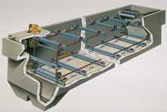
Clarifiers used may be rectangular or circular. In rectangular clarifiers, wastewater flows from one end to the other, and the settled sludge is moved to a hopper at the one end, either by flights set on parallel chains or by a single bottom scraper set on a traveling bridge. Floating material (mostly grease and oil) is collected by a surface skimmer.
In circular tanks, the wastewater usually enters at the middle and flows outward. Settled sludge is pushed to a hopper in the middle of the tank bottom, and a surface skimmer removes floating material.

Slide 7
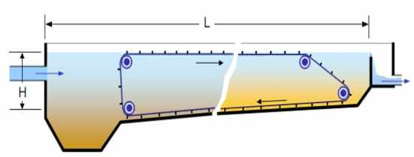
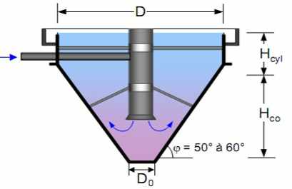
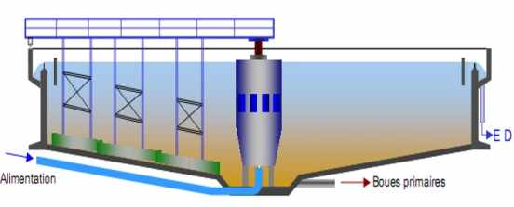
Different type of clarifiers disguised by WW flow direction and evacuating sludge system

Slide 8
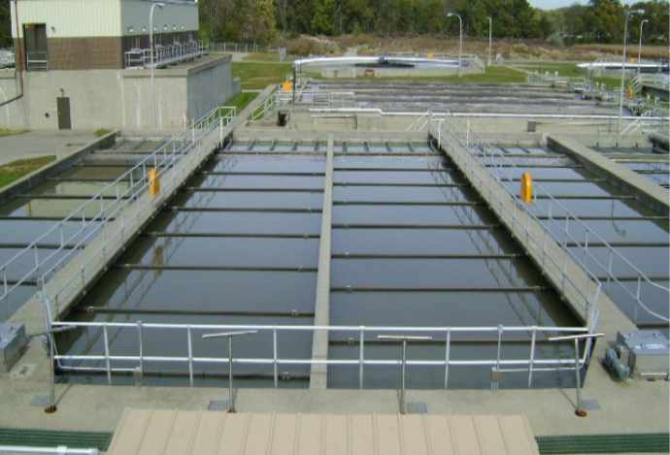
Preliminary treatment: primary sedimentation
http://www.fairfield-city.org/images/ww/Primaries.JPG

Slide 9
Secondary treatment
The main purpose of secondary treatment is to provide BOD removal beyond what is achievable by primary treatment.
There are three commonly used approaches, two of these approaches, the trickling filter (Fixed biomass) and the activated sludge process (floating biomass), sequentially follow normal primary treatment.
The third, ponds (oxidation ponds or lagoons), can provide equivalent results without preliminary treatment

Slide 10
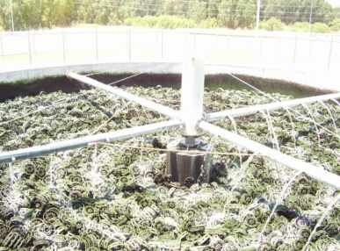
Secondary treatment: trickling filters
Trickling Filters are tanks filled with solid media (plastic, stones) over which the WW is trickled
a bio-film grows on the media and metabolizes the organics in the WW, using natural or forced air draught
The film sloughs off, requiring a secondary clarifier to separate the sludge from the ‘secondary effluent’

Slide 11
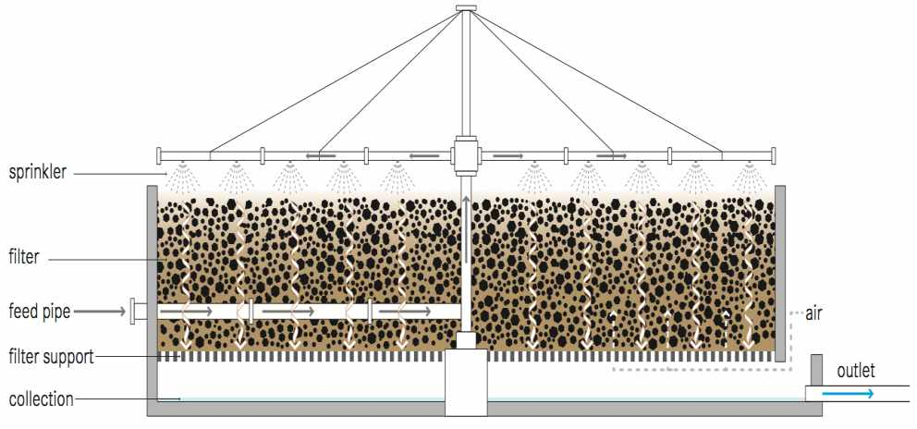
Trickling filter
Notes:
Trickling filters are compact, although they are still best suited for peri-urban or large, rural settlements.

Slide 12
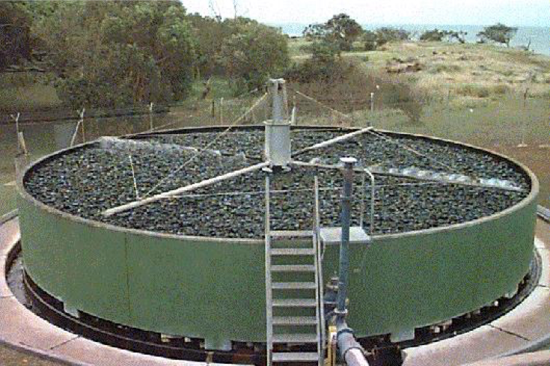
Secondary treatment: trickling filters

Slide 13
Secondary treatment: activated sludge
The basic components of an activated sludge sewage treatment system include an aeration tank and a secondary clarifier.
Primary effluent is mixed with settled solids (biomass) recycled from the secondary clarifier and is then introduced into the aeration tank.
Air is supplied continuously into the mixture.
Wastewater is fed continuously into an aerated tank, where the microorganisms metabolize and biologically flocculate the organics.
Microorganisms (activated sludge) are settled from the aerated mixed liquor in the final clarifier and are returned to the aeration tank. A portion of the concentrated solids from the bottom of the settling tank must be removed from the process (waste activated sludge).
Notes:
An activated sludge process refers to a multi-chamber reactor unit that makes use of highly concentrated microorganisms to degrade organics and remove nutrients from wastewater to produce a high-quality effluent.
To maintain aerobic conditions and to keep the activated sludge suspended, a continuous and well-timed supply of oxygen is required.
Different configurations of the activated sludge process can be employed to ensure that the wastewater is mixed and aerated in an aeration tank.

Slide 14
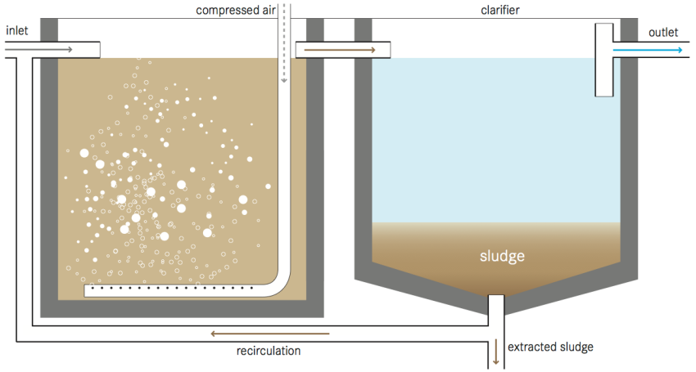
Activated sludge process
Notes:
The basic components of an activated sludge sewage treatment system include an aeration tank and a secondary clarifier.
Primary effluent is mixed with settled solids (biomass) recycled from the secondary clarifier and is then introduced into the aeration tank.
Aeration and mixing can be provided by pumping air or oxygen into the tank or by using surface aerators.
The microorganisms oxidize the organic carbon in the wastewater to produce new cells, carbon dioxide and water. Although aerobic bacteria are the most common organisms, facultative bacteria along with higher organisms can be present. The exact composition depends on the reactor design, environment, and wastewater characteristics.
The flocs (agglomerations of sludge particles), which form in the aerated tank, can be removed in the secondary clarifier by gravity settling. Some of this sludge is recycled from the clarifier back to the reactor. The effluent can be discharged into a river or treated in a tertiary treatment facility if necessary for further use.

Slide 15
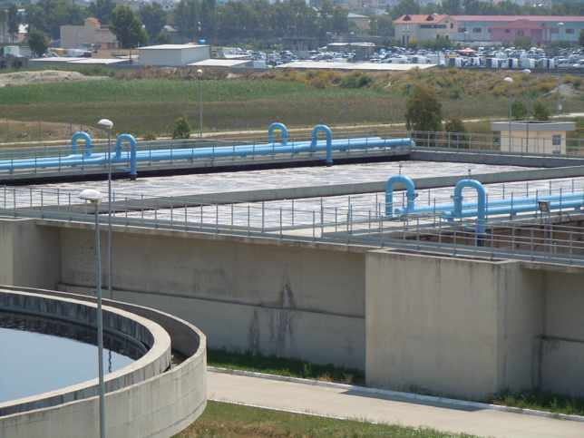
Secondary treatment: activated sludge
Treatment plant Durres, Albania

Slide 16
Secondary treatment: Waste Stabilization Pond
Waste Stabilization Ponds (WSPs) are large, man- made water bodies. The ponds can be used individually, or linked in a series for improved treatment. There are three types of ponds,
(1) anaerobic,
(2) facultative and
(3) aerobic (maturation),
each with different treatment and design characteristics.
Ponds are relatively easy to build and manage, can accommodate large fluctuations in flow. The actual degree of treatment provided depends on the type and number of ponds used.
Ponds can be used as the sole type of treatment or they can be used in conjunction with other forms of wastewater treatment (i.e., other treatment processes followed by a pond or a pond followed by other treatment processes).

Slide 17
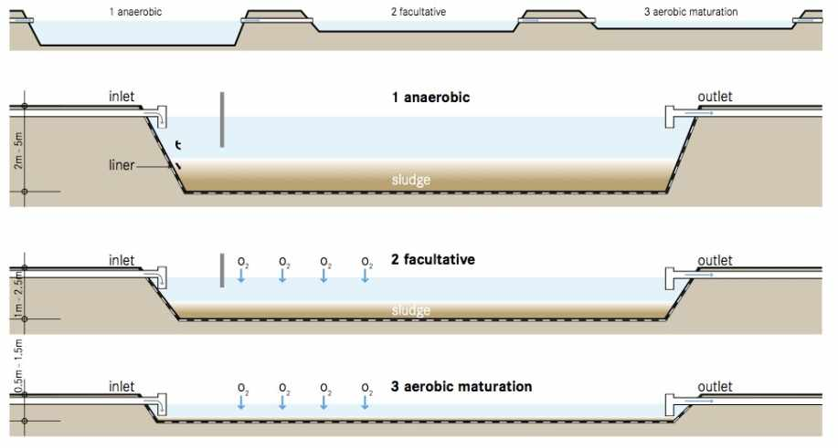
Secondary treatment: Waste Stabilization Pond
Compendium of Sanitation Systems and Technologies

Slide 18
Systems and Technologies
Waste stabilization ponds
A pond-system comprises:
anaerobic sedimentation ponds,
alternating facultative (aerobic) ponds and
several maturation ponds (post-treatment ponds)
Anaerobic Pond
Facultative Pond
Maturation Ponds
Design | Deep (2-5m) and highly loaded but rather small area | Shallow (<1.5m) but large → Oxygen supply (algae, wind, artificial aeration) | Shallow (<1m) but large area
Flow | Hydraulic retention time: 1 to 3 days | Hydraulic retention time: 10 to 20 days | Hydraulic retention time: 10 days
Function | Sedimentation and anaerobic stabilisation of sludge (BOD reduction 40-50%) → settling | Aerobic degradation of suspended and dissolved matter (BOD reduction 50-70%) → degradation | Final sedimentation of suspended solids, bacteria mass and pathogens → hygienization
Notes:
Ponds are large, man-made water bodies allowing the wastewater to be treated by a naturally occurring process.

Slide 19
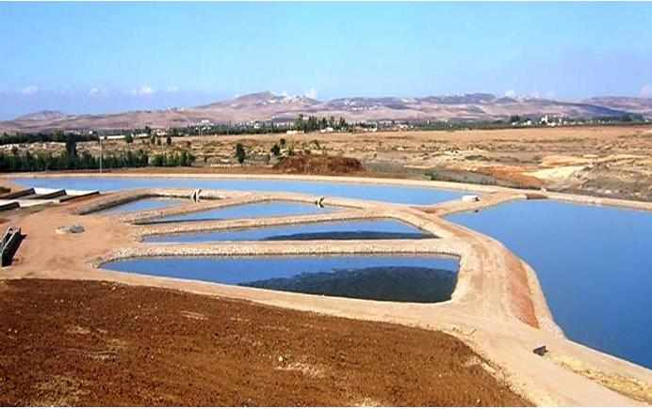
Stabilization Pond (natural)

Slide 20
Secondary treatment: Biogas reactor
A biogas reactor or anaerobic digester is an anaerobic treatment technology that produces
a digested slurry (digestate) that can be used as a fertilizer and
biogas that can be used for energy.
A biogas reactor is an airtight chamber that facilitates the anaerobic degradation of blackwater, sludge, and/ or biodegradable waste.
This technology can be applied at the household level, in small neighbourhoods or for the stabilization of sludge at large wastewater treatment plants. It is best used where regular feeding is possible.
Notes:
slurry‬ : a semiliquid mixture‬

Slide 21
Secondary treatment: Biogas reactor, Pros & Cons:
+ Generation of renewable energy + Small land area required (most of the structure can be built underground) + No electrical energy required + Conservation of nutrients + Long service life + Low operating costs - Requires expert design and skilled construction - Incomplete pathogen removal, the digestate might require further treatment

Slide 22
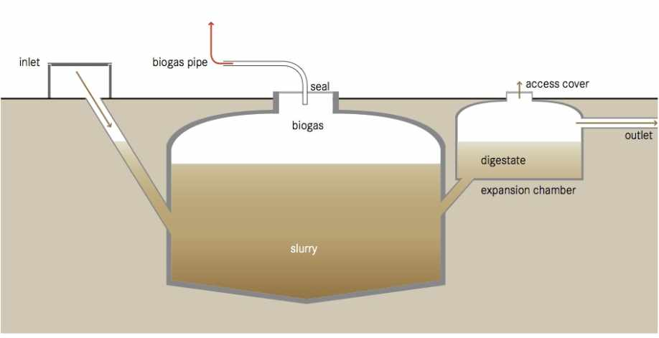
Secondary treatment: Biogas reactor
Compendium of Sanitation Systesm and Technologies

Slide 23
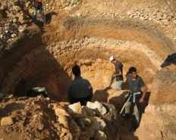
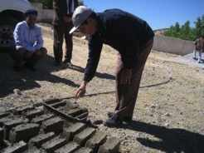
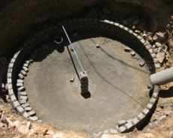
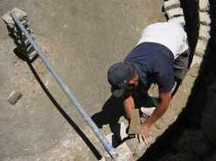
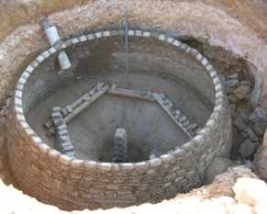
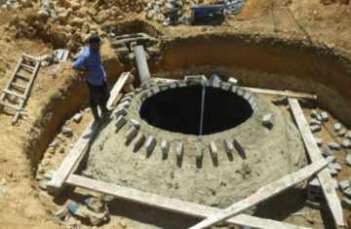
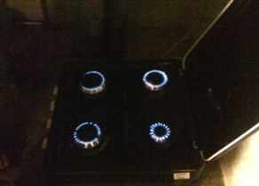
Construction of Biogas reactor

Slide 24
Sludge handling
The ultimate purpose is the conversion of wastewater sludge into a form that can be handled economically and disposed off without damaging the environment or creating nuisance conditions
Sludge treatment accounts for more than half of the total costs in a typical secondary treatment plant
Sludge treatment methods are generally divided into three major categories:
thickening,
stabilization including inactivation of pathogenic organisms, and
dewatering

Slide 25
Sludge handling: co-composting
A ratio of 1:2 to 1:3 between dewatered sludge/UDDT matter and organic waste is mixed
Mixed material is piled into long heaps (windrows) and left to decompose for approx. 3 months
Windrows are turned periodically to provide oxygen and ensure that all parts of the pile are subjected to the same heat treatment
Piles should be insulated with compost or soil to promote an even distribution of heat
Careful planning and design required to avoid failure

Slide 26
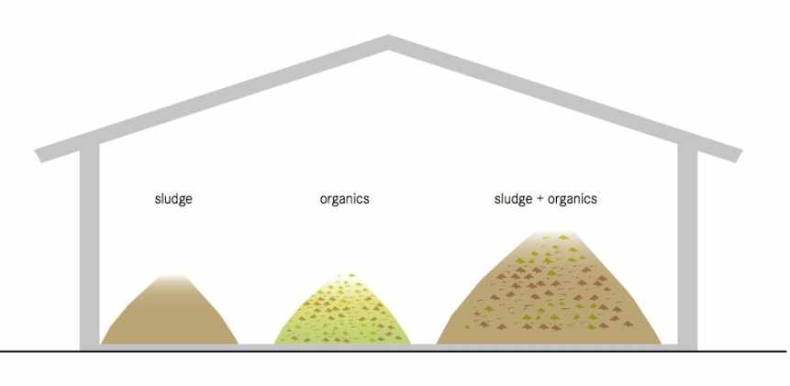
Sludge handling: co-composting
Notes:
A ratio of 1:2 to 1:3 between dewatered sludge/UDDT matter and organic waste is mixed
Mixed material is piled into long heaps (windrows) and left to decompose for approx. 3 months
Windrows are turned periodically to provide oxygen and ensure that all parts of the pile are subjected to the same heat treatment
Piles should be insulated with compost or soil to promote an even distribution of heat
Careful planning and design required to avoid failure

